Slide 1
Xamarin Slides Guidelines
Here you’ll find guidelines for designing your Xamarin presentations.
White slides with “GUIDELINES” in the lower right corner are not sample slides for use in your presentations – please hide or delete guideline slides.
You’ll also find icons and device frames for use on your slides in the guidelines.

Slide 2
Presentation Fonts
We are using Segoe UI for normal text. Download Segoe UI:
https://www.dropbox.com/s/hpkow9i6398jm04/Segoe.zip
We are using Menlo for code. Download Menlo:
https://www.dropbox.com/s/c0r9812b67dy1ay/Menlo.ttc
Title uses Segoe UI 110pt
Section headings use Segoe UI 130pt
Subtitles use Segoe UI 60pt
Content uses Segoe UI 45pt
Big number slides use Helvetica light 280pt
Quotations use Segoe UI 62pt.

Slide 3
Color Palette
Light blue
R 59 G 153 B 212
Hex #3B99D4
R 118 G 130 B 130
Hex #768282
Grey
Dark blue
R 21 G48 B 78
Hex #15304E
Blue Grey dark
R 43 G 62 B 80
Hex #2B3E50
R 169 G 86 B 160
Hex #A956A0
Grey 2 Dark
R 180 G 188 B 188
Hex #B4BCBC
Purple
R 126 G 195 B 104
Hex #7EC368
Grey 2 Light
R 236 G 240 B 241
Hex #ECF0F1
Green

Slide 4
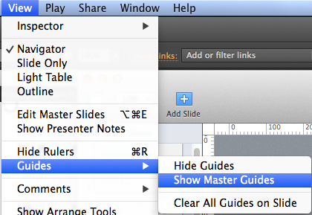
Use the grid to align slides nicely
The grid guides are in the master slide.
Click PowerPoint View menu a long on the top, and then go to Guides, and select Show Master Guides
If you want to hide the grid guides, select Hide Master Guides in the same menu.

Slide 5
Using the Xamarin logo
Our logo=Xamagon+ Xamarin logotype
Clear space
Logo
X
X
X
Xamagon
Xamarin logotype
X
Minimum size
On-screen 150px

Slide 6

Using the Xamarin logo on color backgrounds
The full-color logo may be placed on any of the colors shown here or on simple areas of photographs.
R 59 G 153 B 212 Hex #3B99D4
R 126 G 195 B 104 Hex #7EC368
R 226 G 231 B 231 Hex #E2E7E7
R 21 G48 B 78 Hex #15304E
R 118 G 130 B 130 Hex #768282
R 169 G 86 B 160 Hex #A956A0
R 43 G 62 B 80 Hex #2B3E50

Slide 7

Using the Xamarin logo
Don’t place the logo on backgrounds that provide insufficient contrast
Don’t add effects like shadows, dimensions, and gradients to the logo
Don’t place the logo over busy photographic background
Partner Program
Don’t create logo “lockups” by adding text in close proximity to the logo
Don’t stretch the logo
Don’t compress the logo

Slide 8
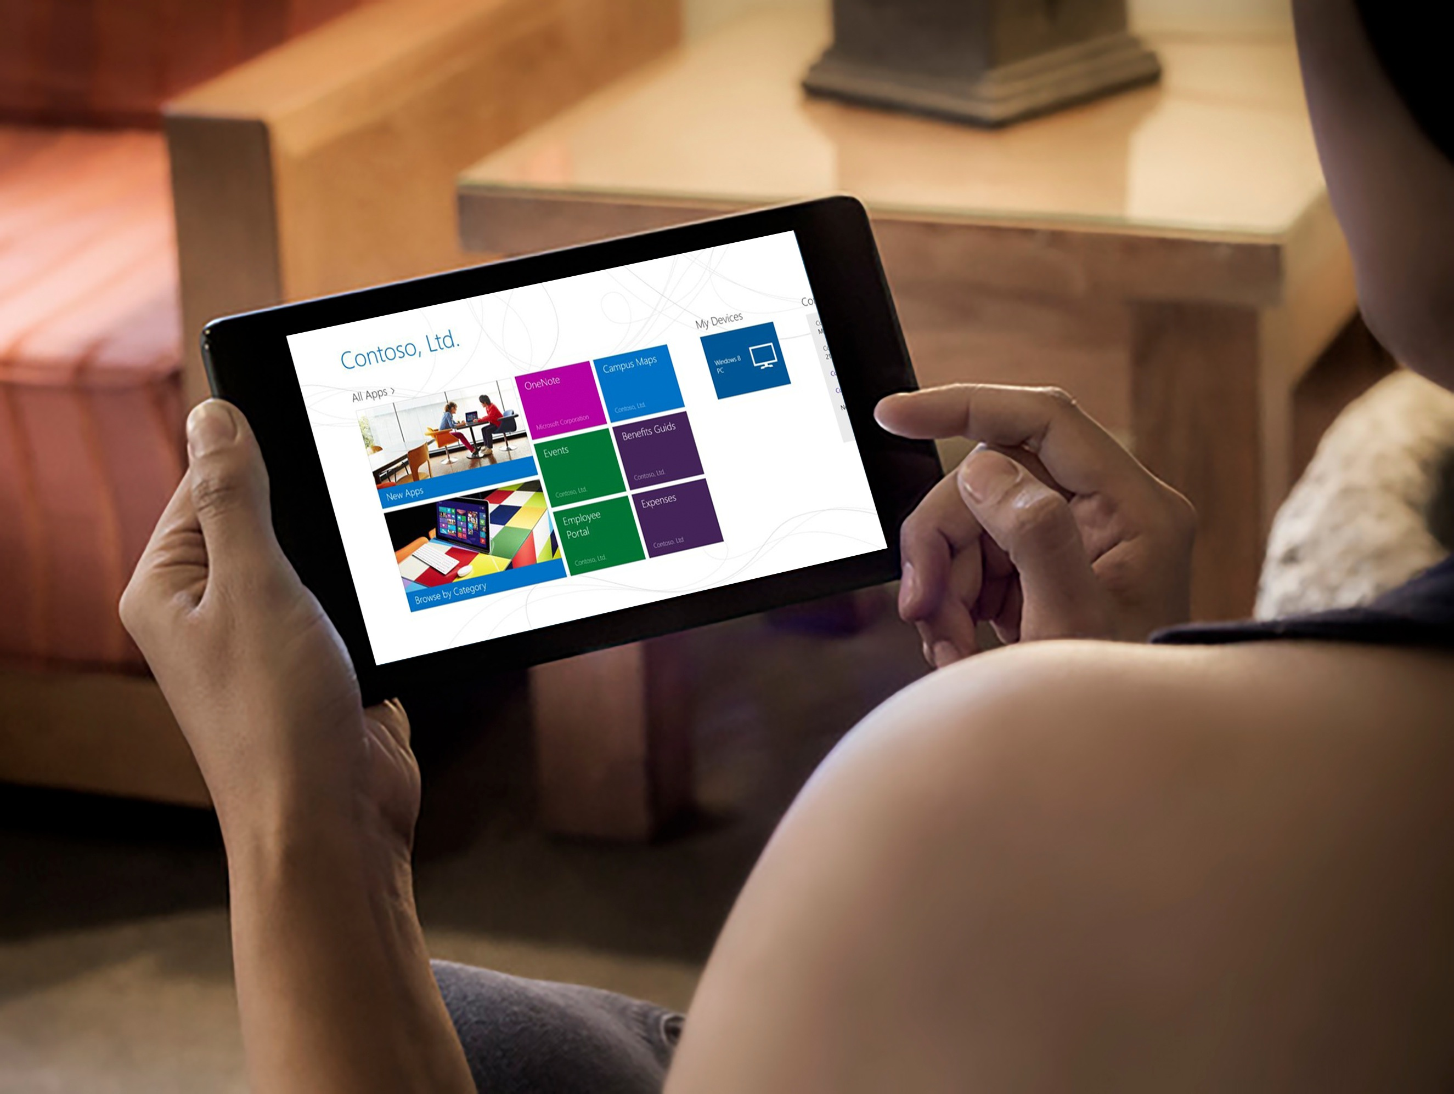
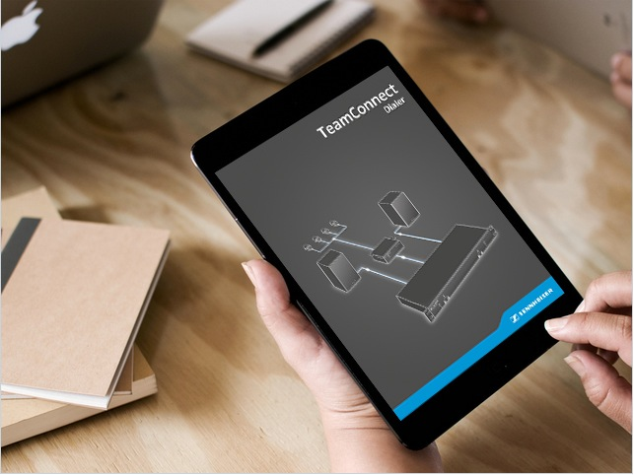

Example: layout three photos
Design Tip: In this instruction, turn on the drawing guides (View -> Guides) to see how the photos and content tiles are aligned to the underlying grid system.
This text shape has no fill. It uses the same default interior margins as content tiles
Align all text blocks to the content tiles interior margins
Text can be used on, above or below photos.

Slide 9
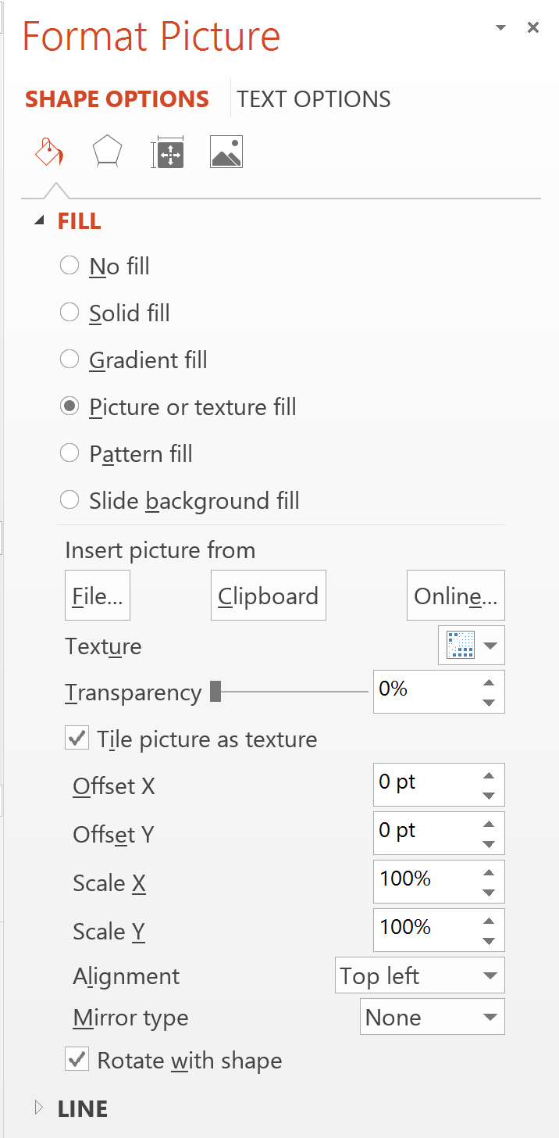
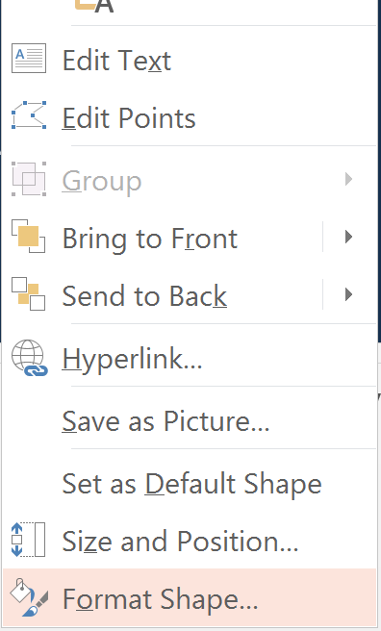
How to insert the photos
210px
280px
Create a rectangle 280px by 210px
Right click on the rectangle to select Format shape
You will see the shape options, select Picture fill and pick your images from your computer.

Slide 10

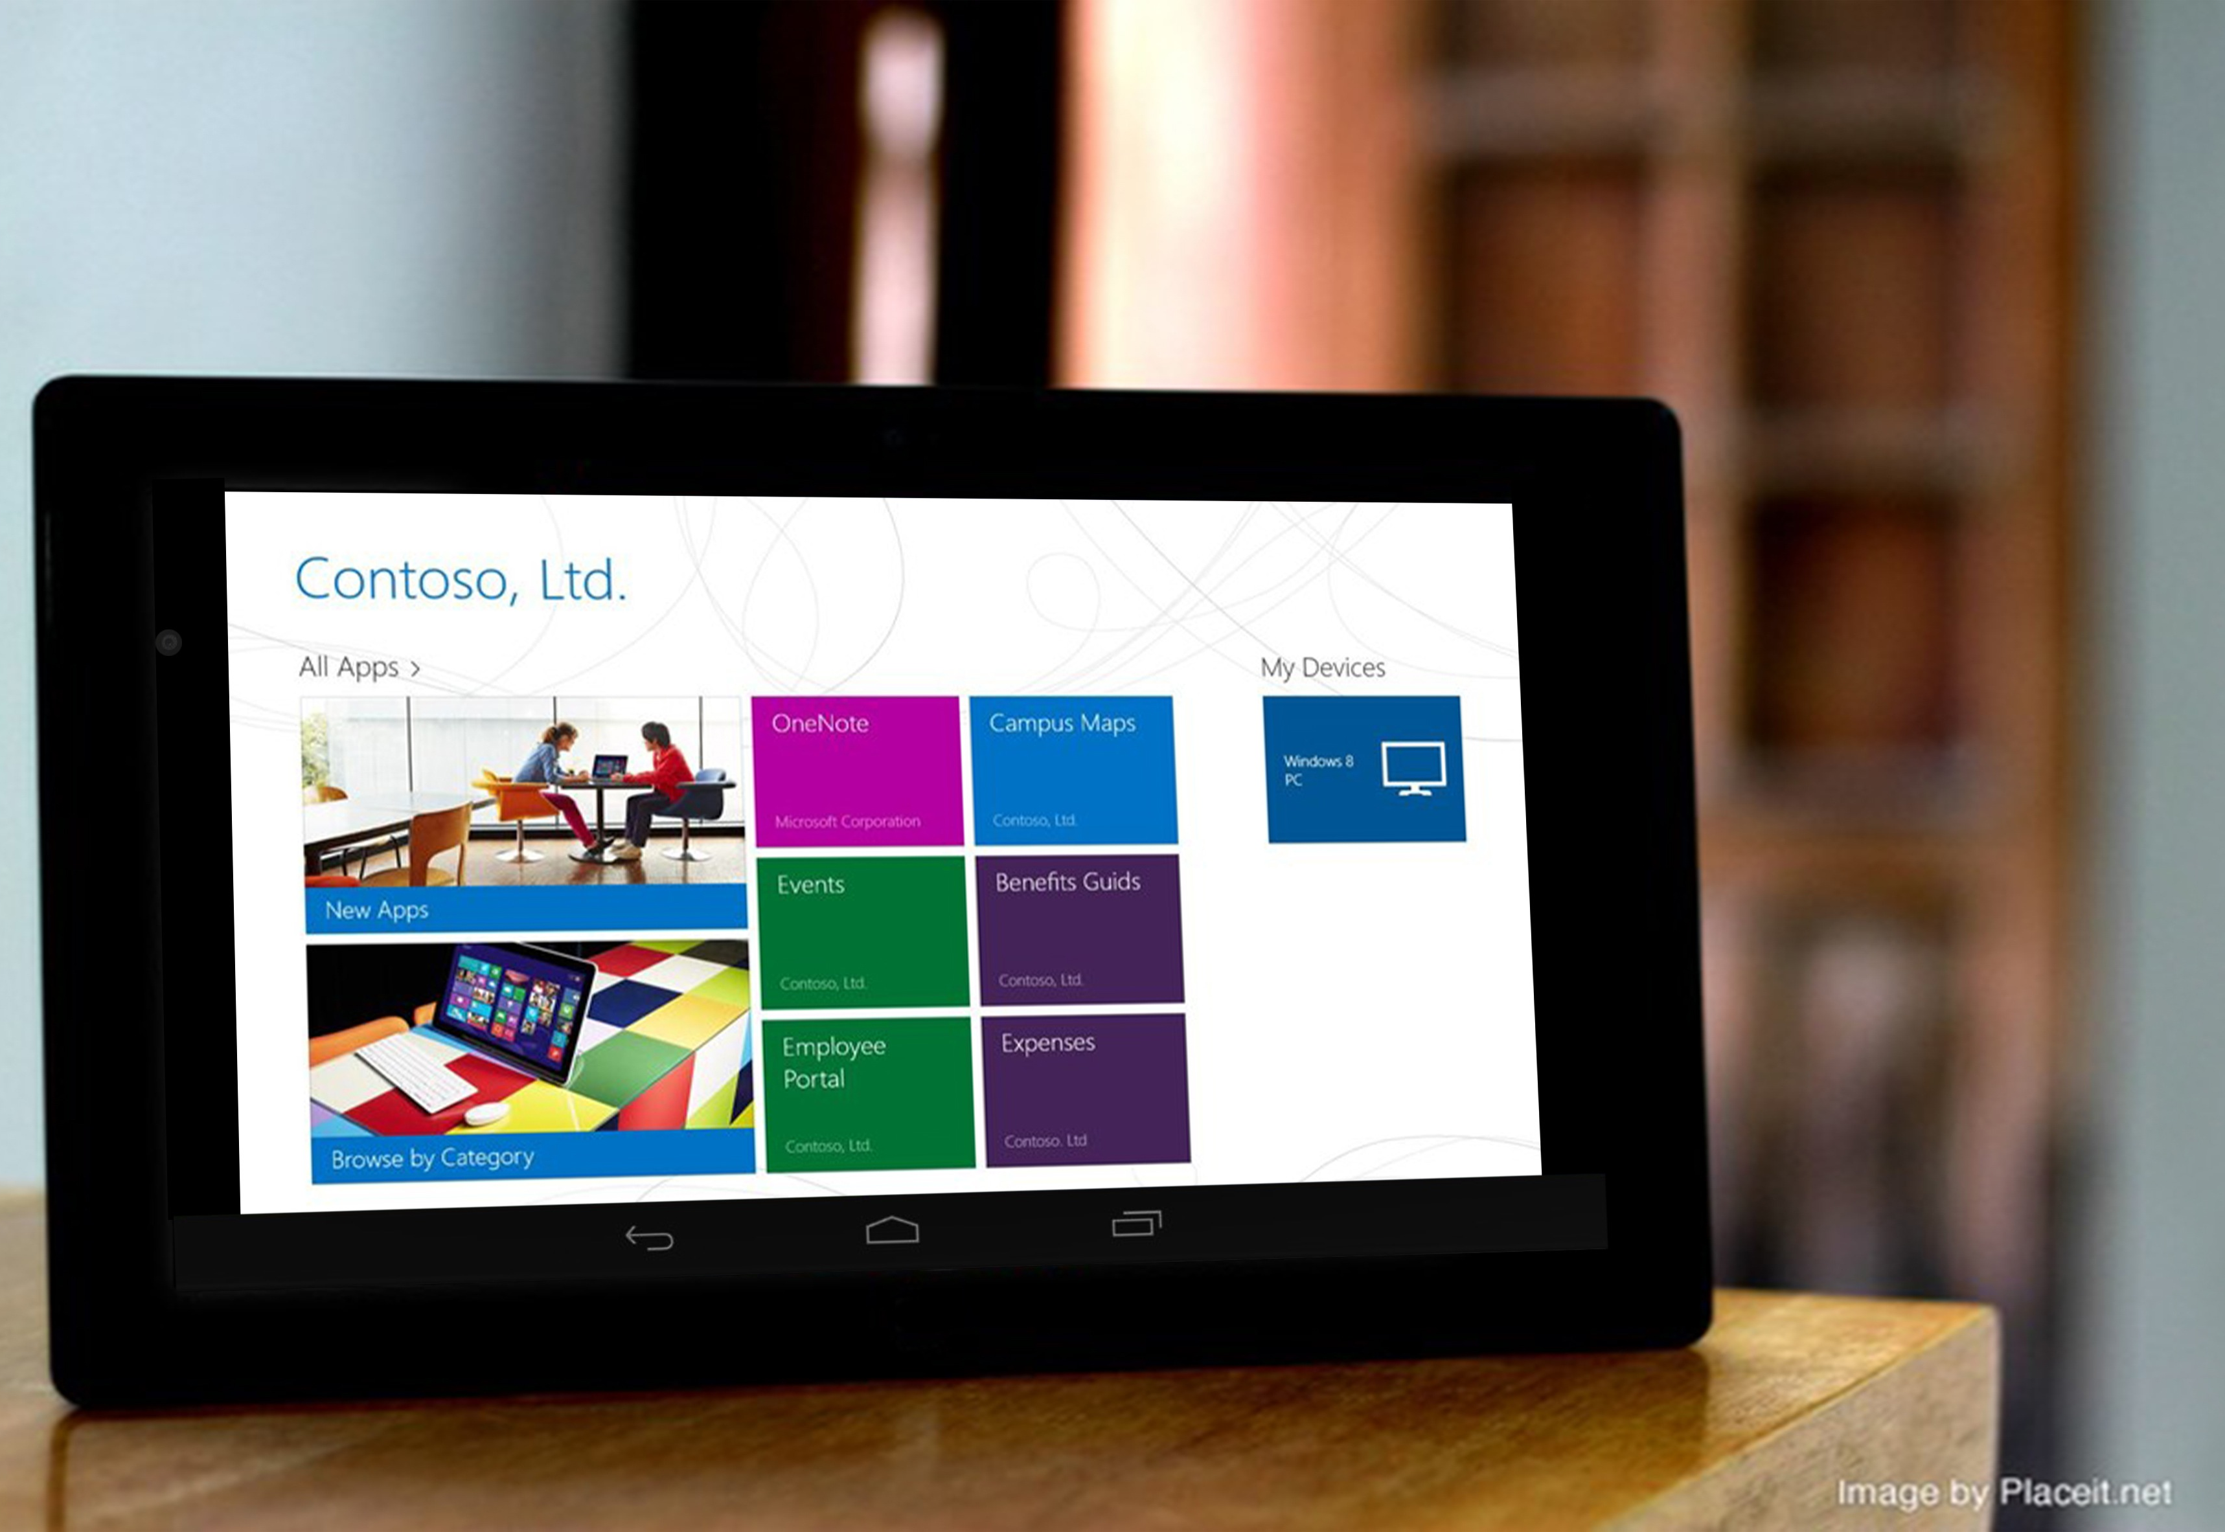
Using device frames
Replace screens with your own full-resolution screenshots.
Use www.placeit.net to generate in natura device shots.

Slide 11
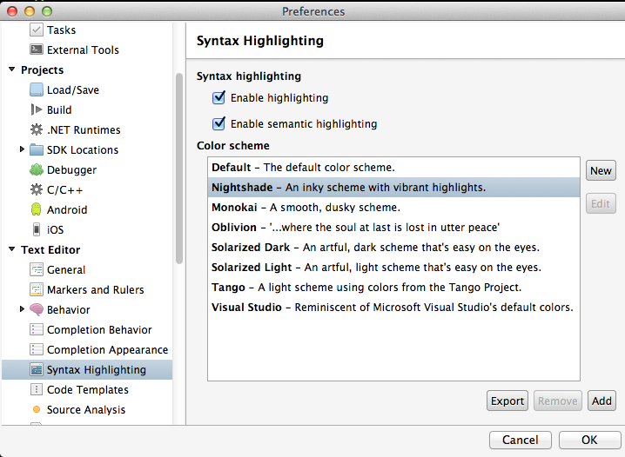
Formatting code
Make sure Xamarin Studio is using the Nightshade colorscheme.
Keep snippets short.
font: Menlo Regular
size: 30pt
line spacing: 1.2

Slide 12
Sample: Pretty code
public override void OnViewCreated (View view, Bundle savedInstanceState) { base.OnViewCreated (view, savedInstanceState);
ListView.DividerHeight = 0; ListView.Divider = null; ListAdapter = new GroceryListAdapter (view.Context, _order.Products);
if (ListAdapter.Count == 0) { checkoutButton.Visibility = ViewStates.Invisible;
} }

Slide 13
Use separate slides to call out sub-snippets
public override void OnViewCreated (View view, Bundle savedInstanceState) { base.OnViewCreated (view, savedInstanceState);
ListView.DividerHeight = 0; ListView.Divider = null; ListAdapter = new GroceryListAdapter (view.Context, _order.Products);
if (ListAdapter.Count == 0) { checkoutButton.Visibility = ViewStates.Invisible;
} }
Notes:
Here, two semitransparent boxes create a fade effect to deemphasize some line, while a bright box is used to add emphasis to a few lines. This is a better approach than using line numbers.

Slide 14
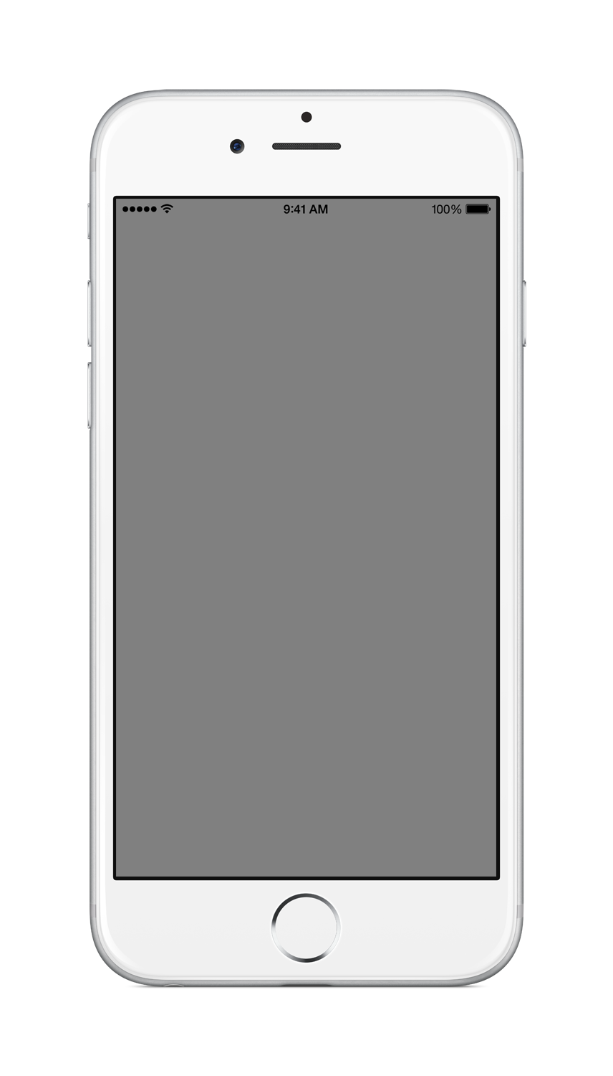
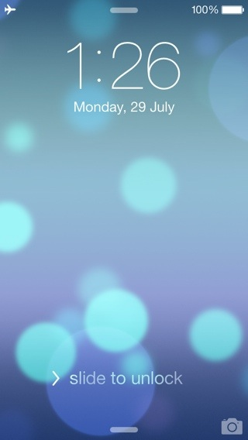
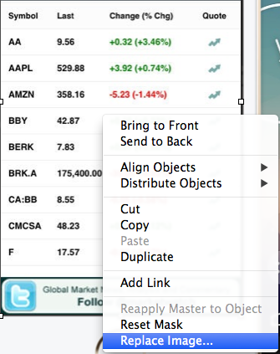
Adding screenshots to devices
Replace device screens by right-clicking on the screen and choosing “Replace Image…”

Slide 15
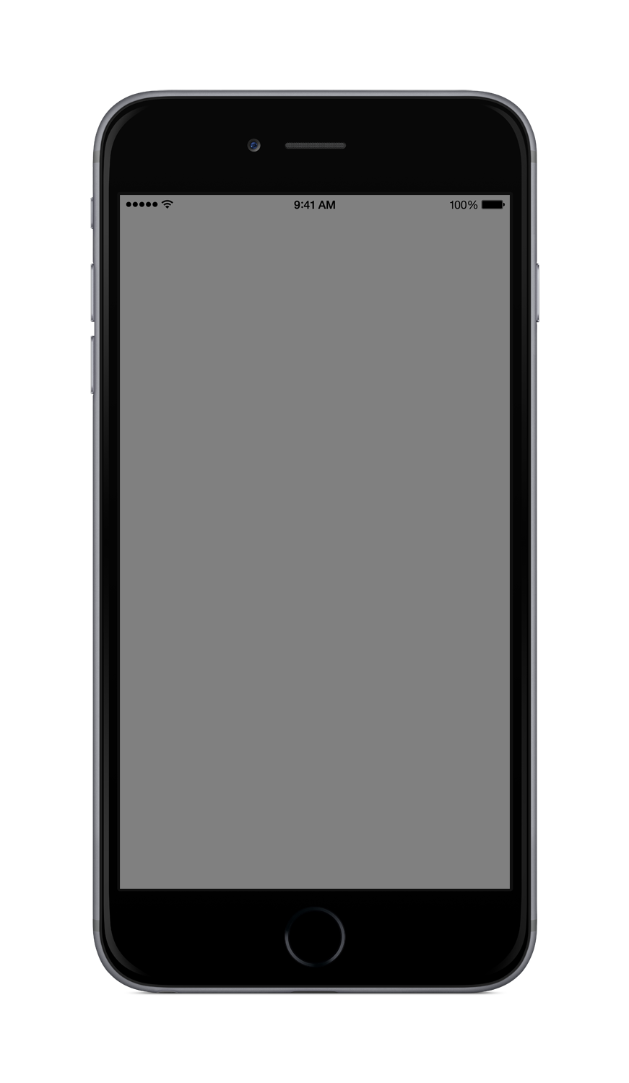
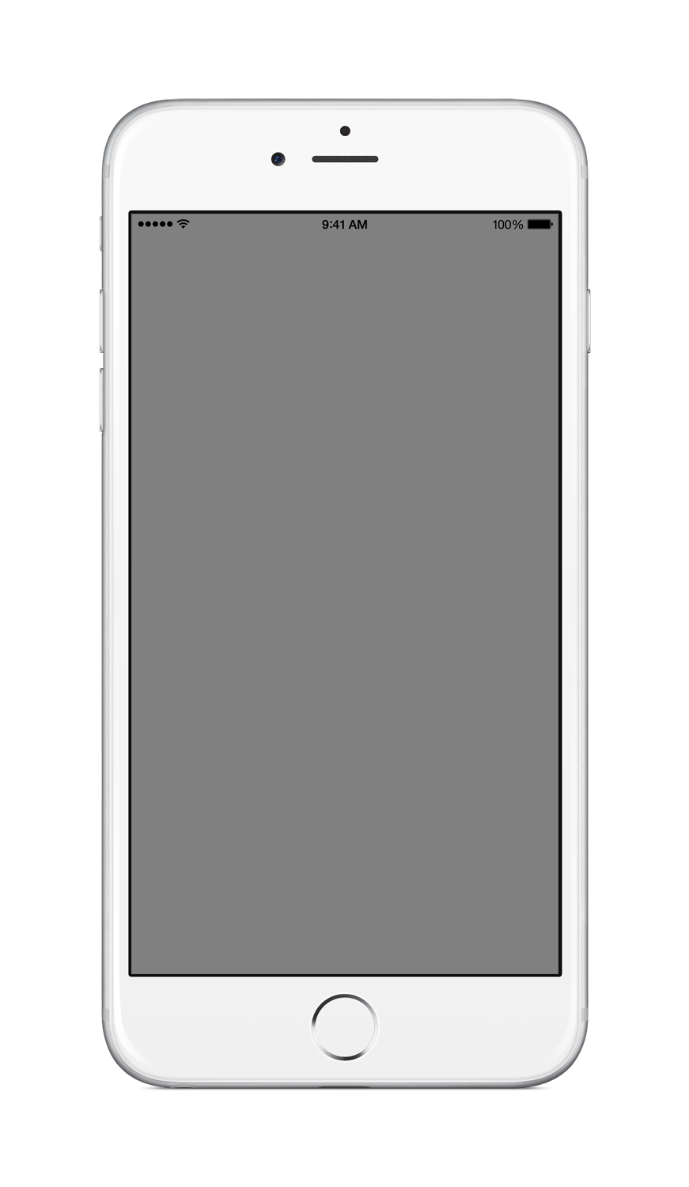
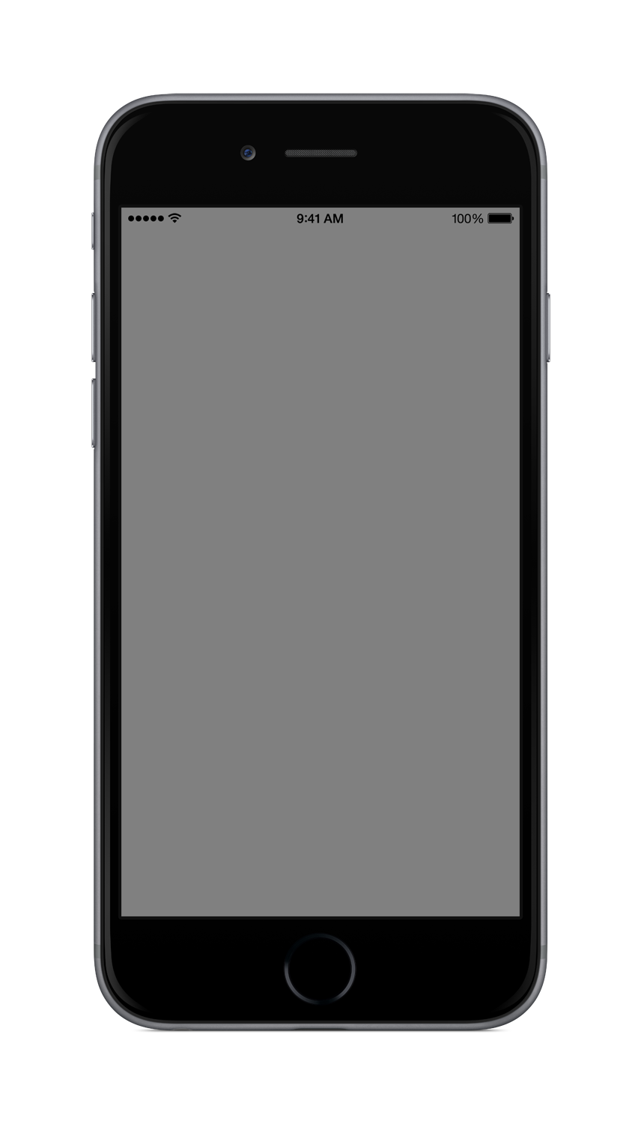
Device Frames – iPhone
iPhone 6
iPhone 6 plus
Notes:
Here are some frames for you to use.

Slide 16
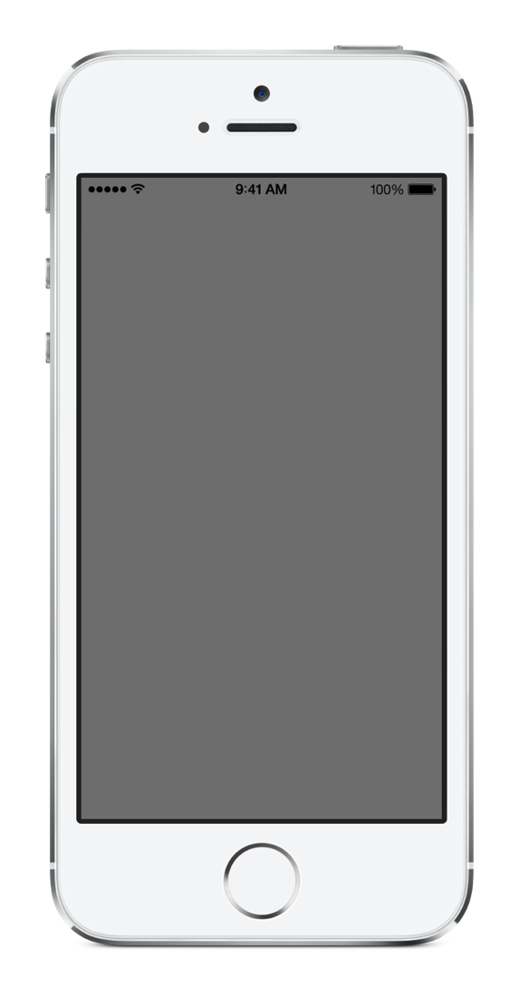
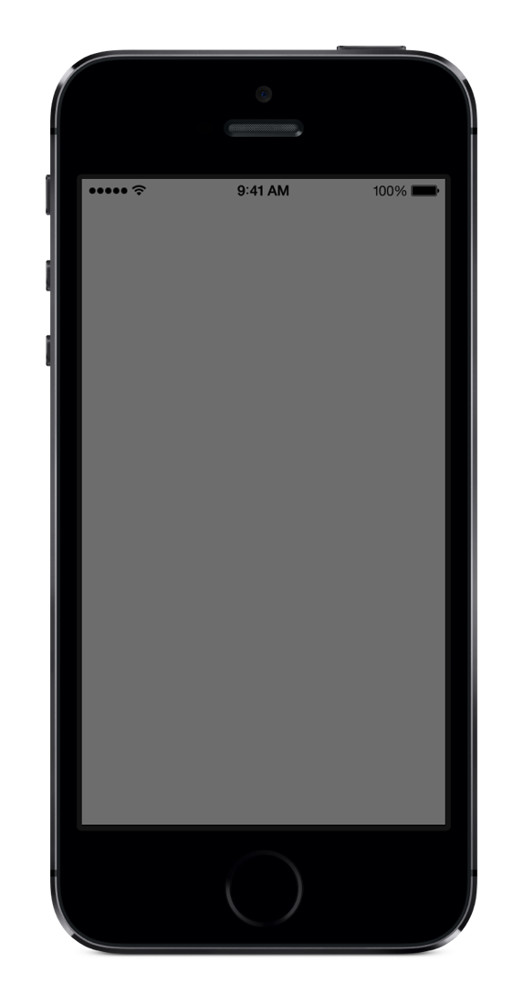
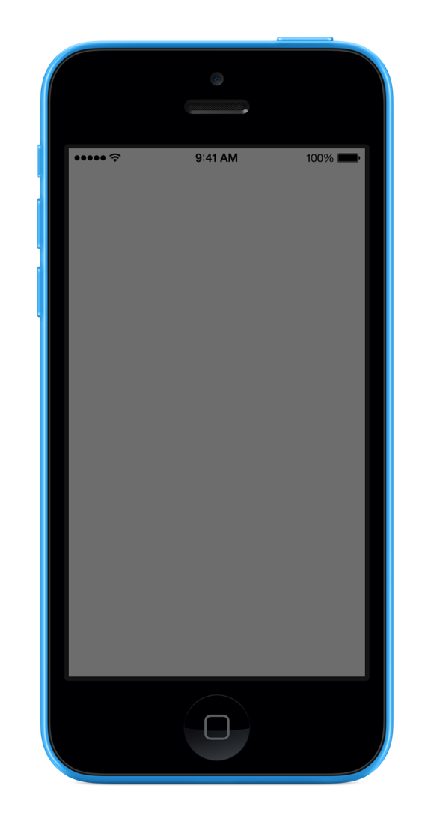
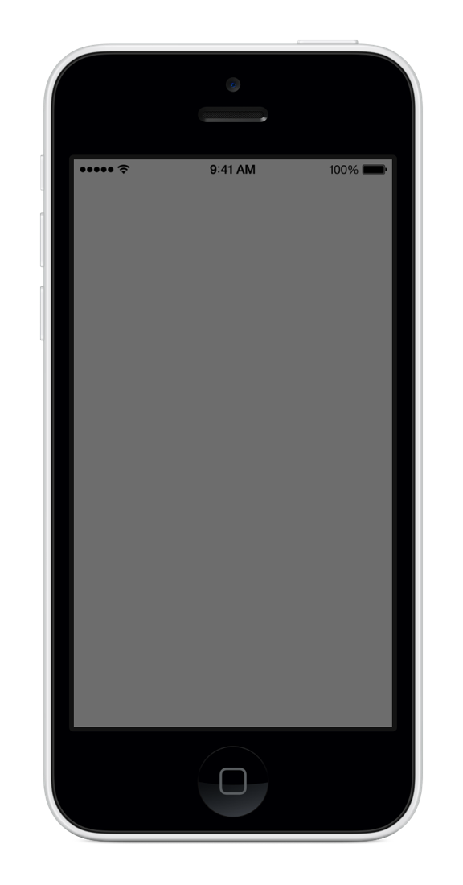
iPhone 5s
iPhone 5c
Notes:
Here are some frames for you to use.

Slide 17
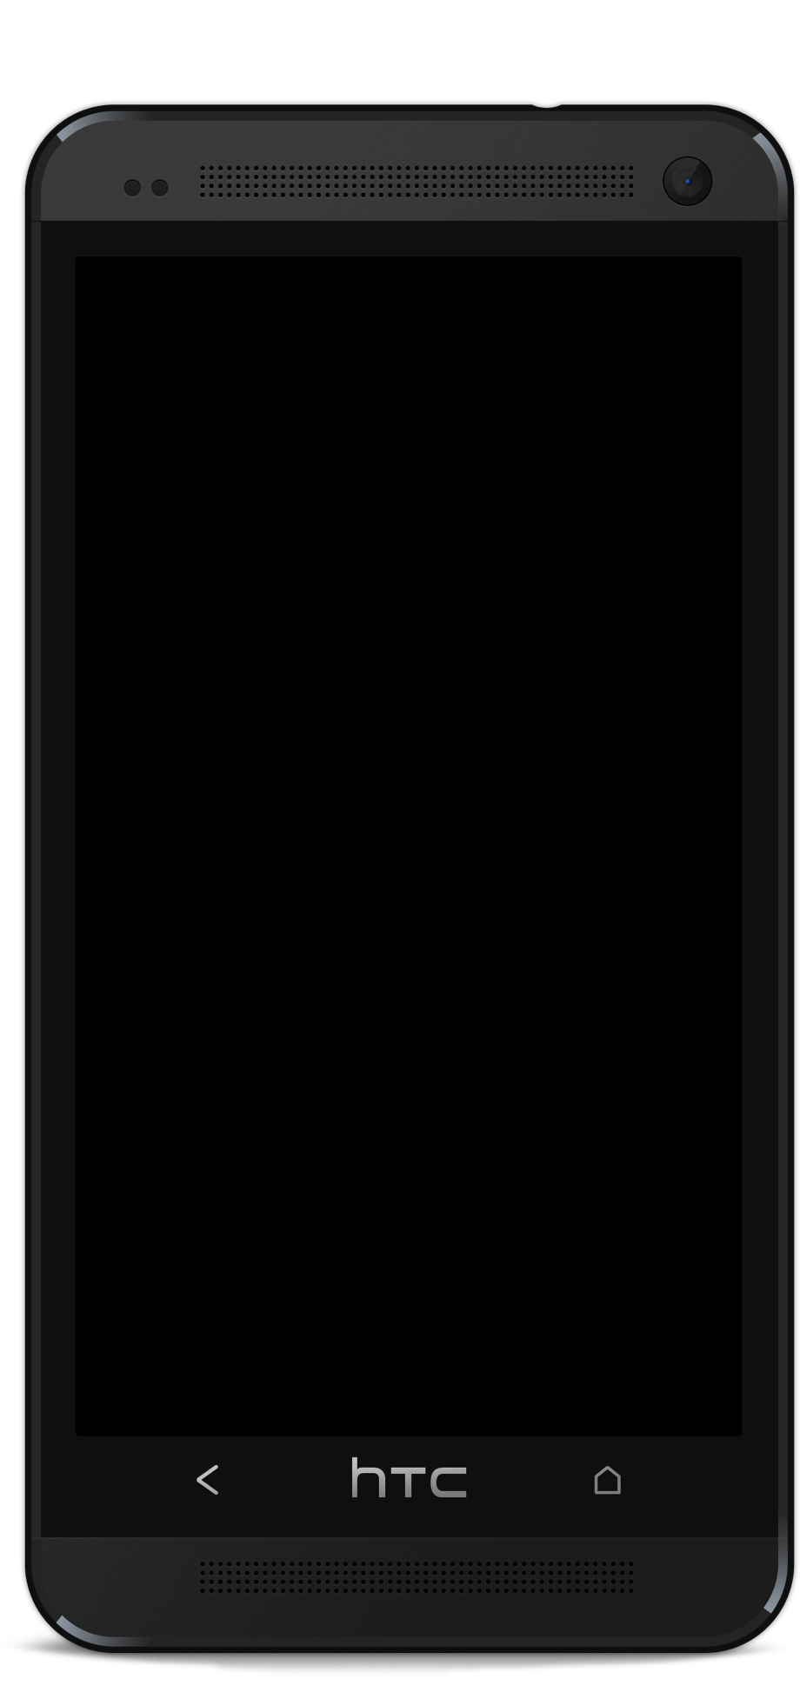
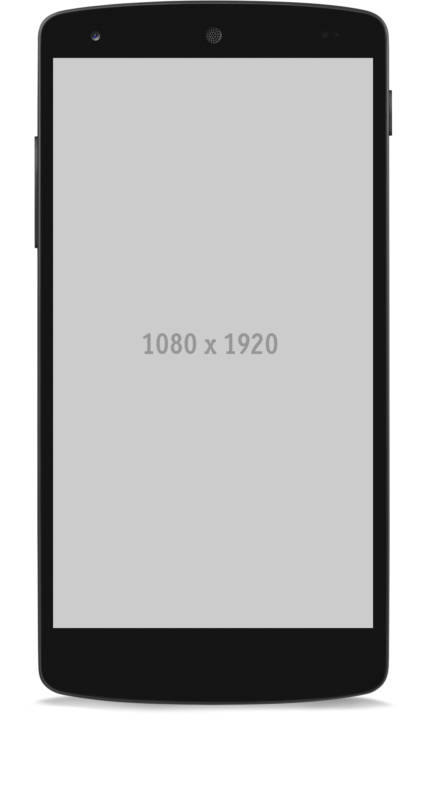
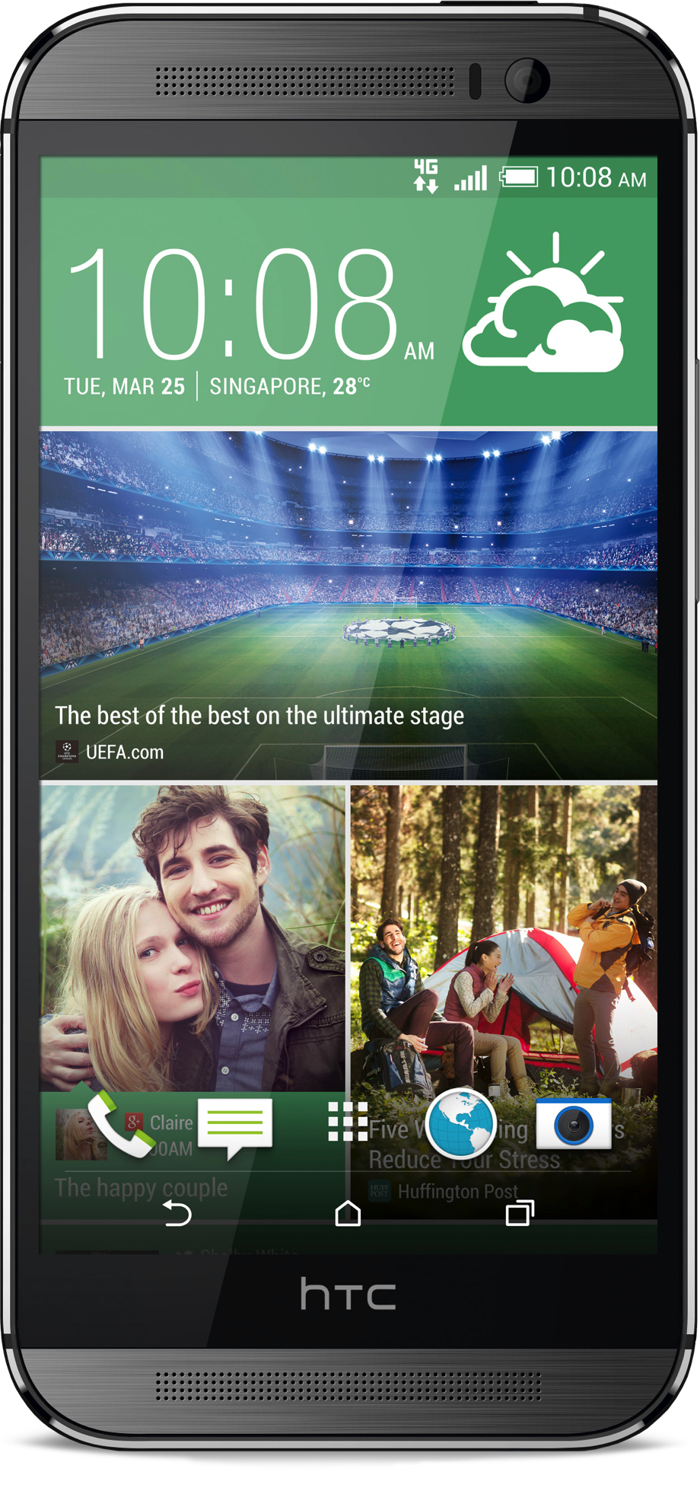
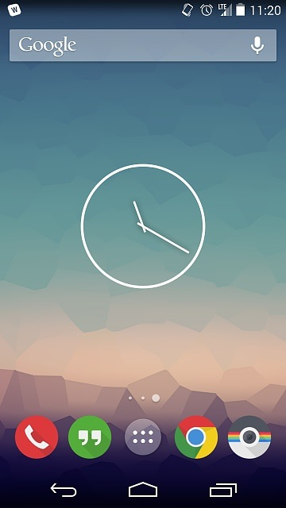
Device Frames Android phone
Nexus 5
HTC
HTC
Notes:
Here are some frames for you to use.

Slide 18
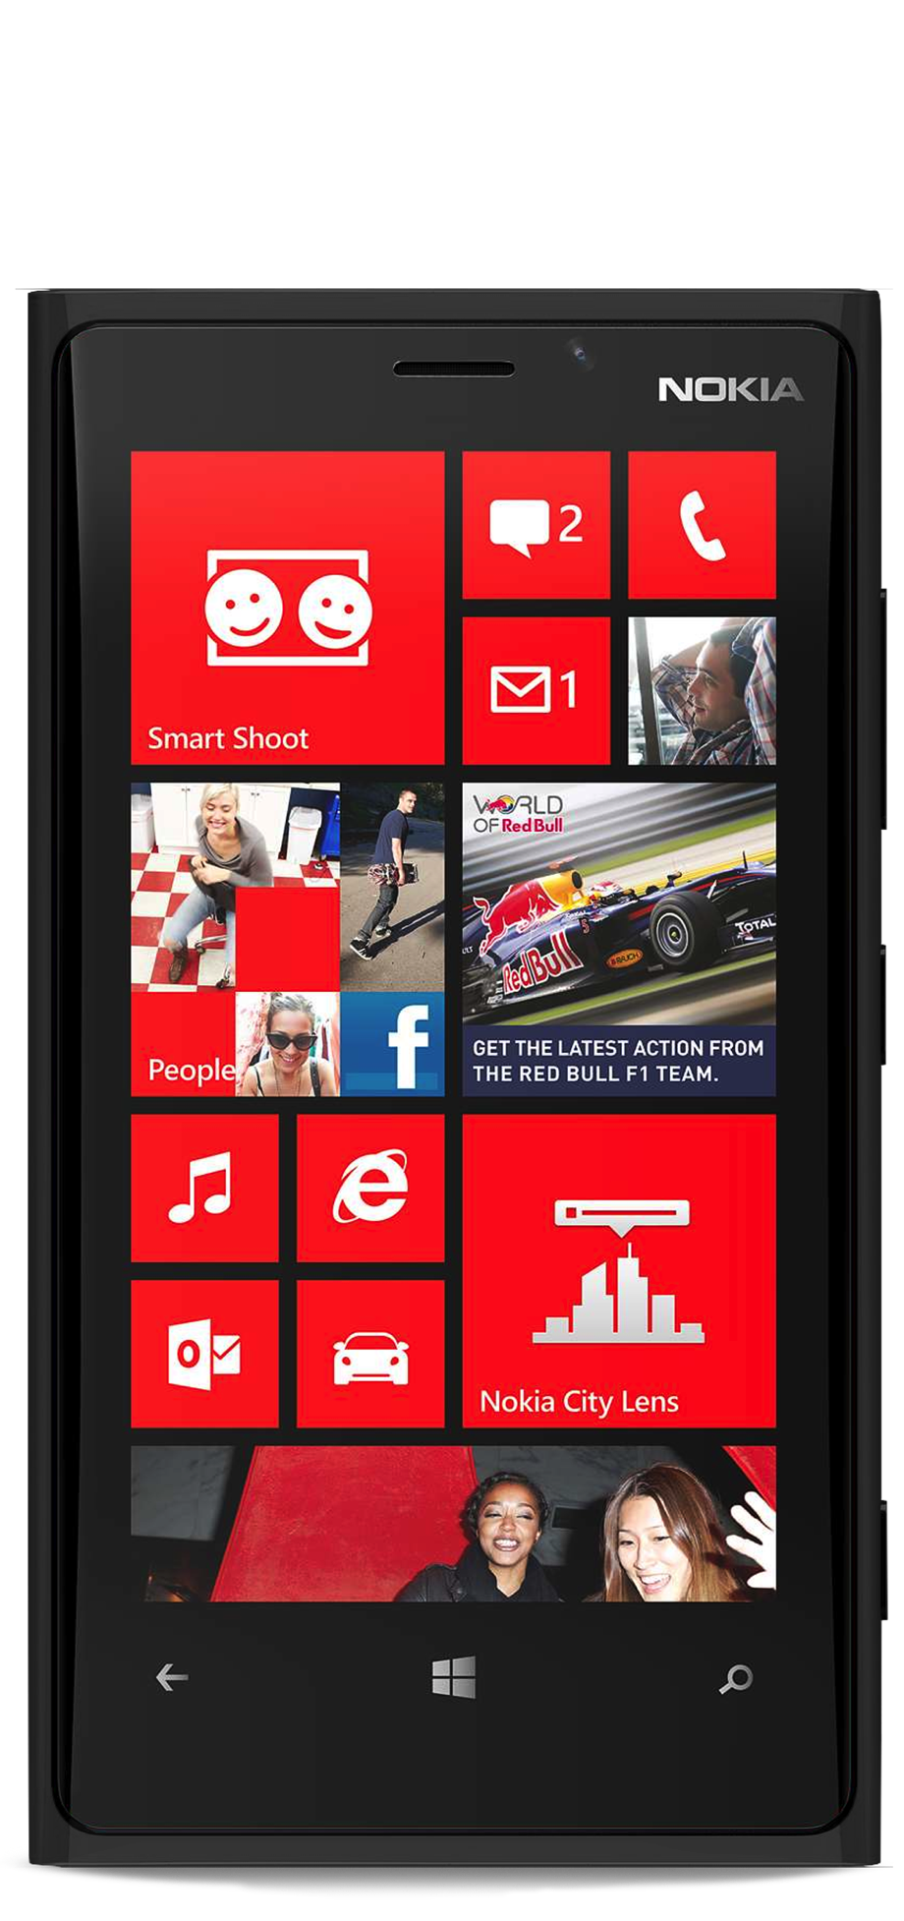
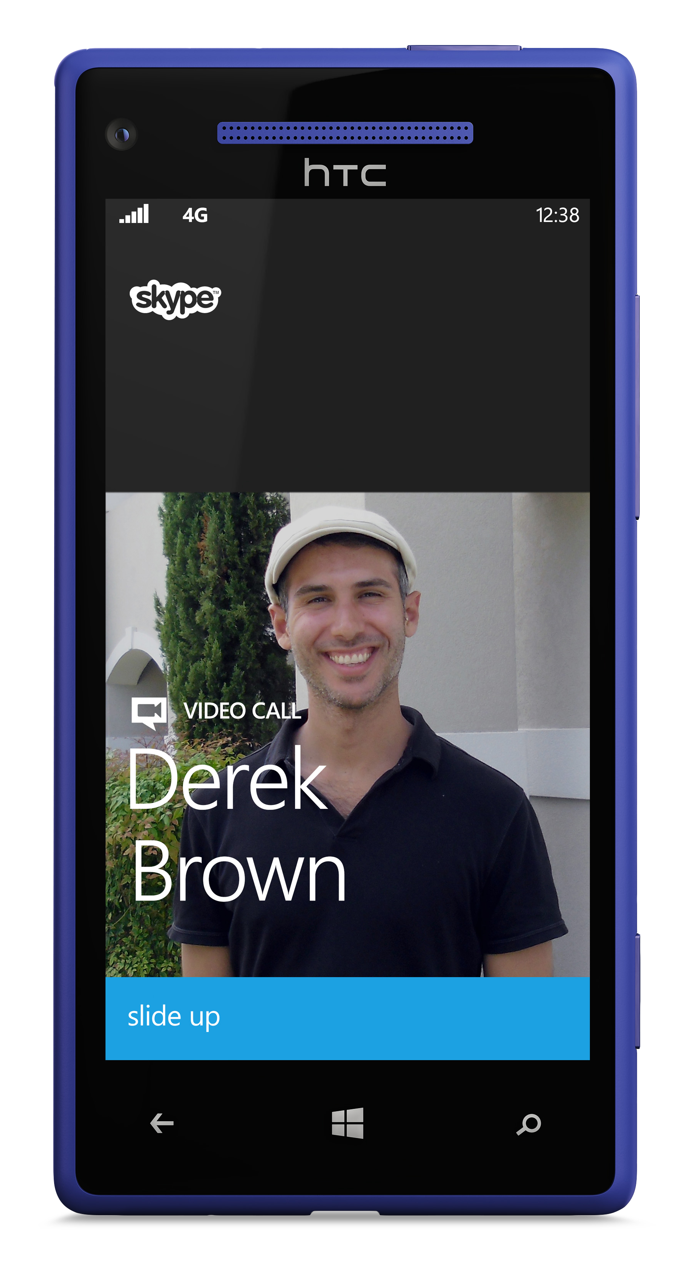
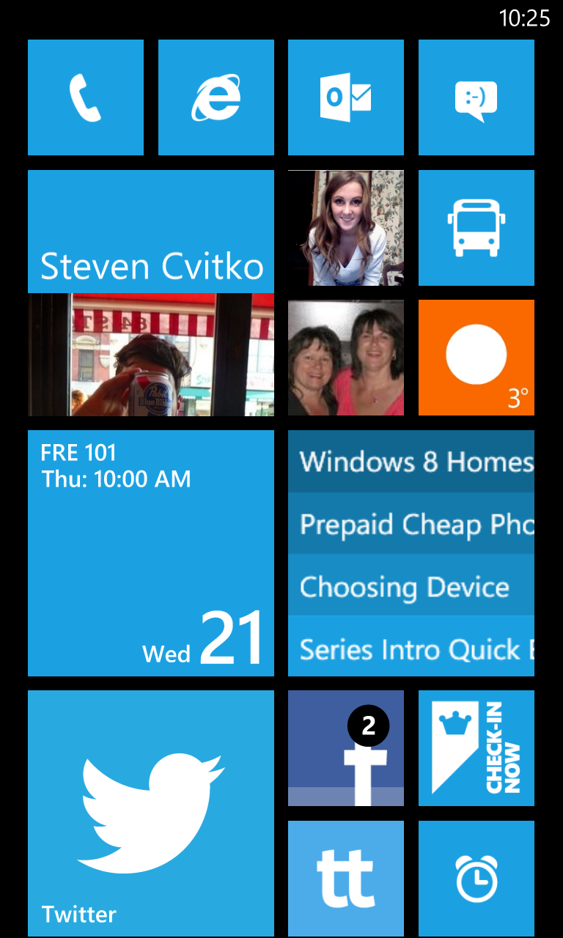
Device Frames Windows phone
Notes:
Here are some frames for you to use.

Slide 19
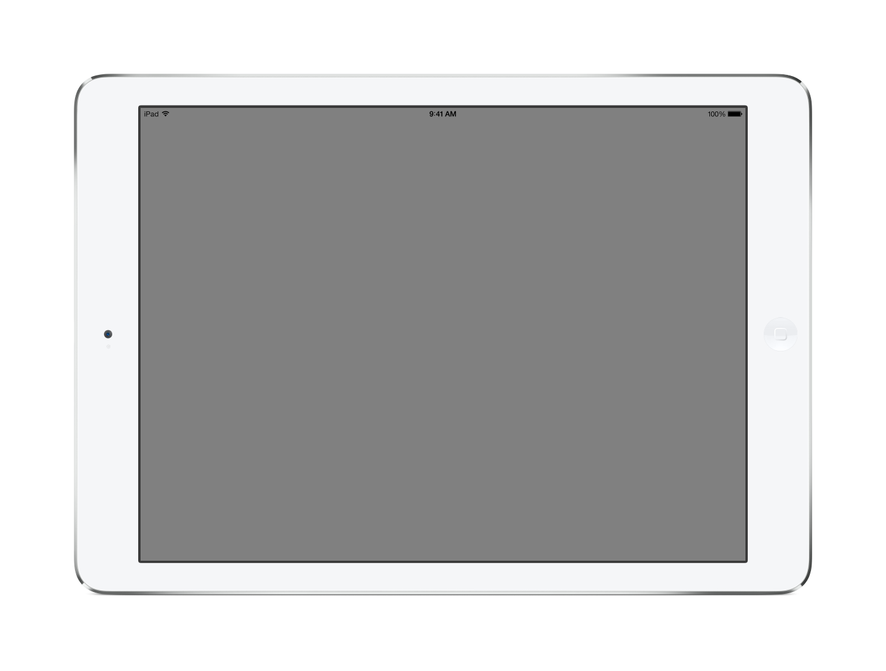
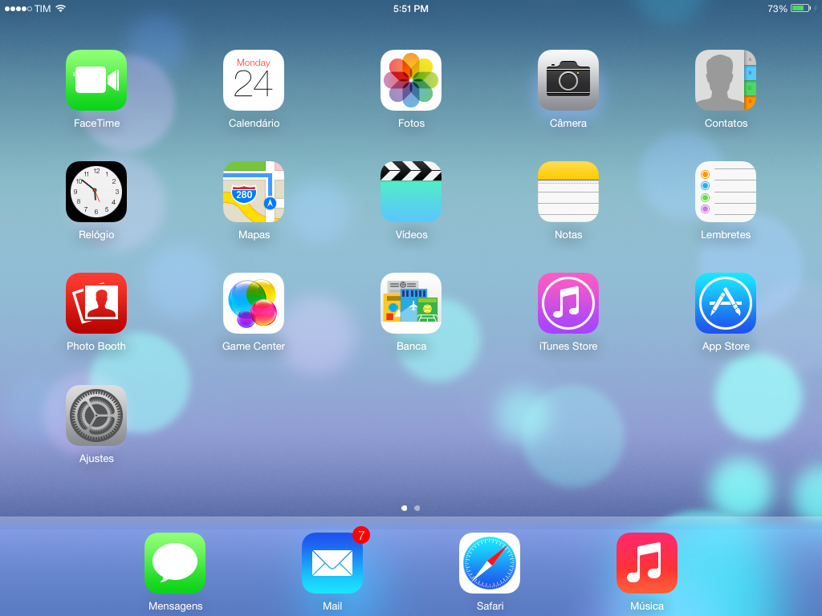

Slide 20
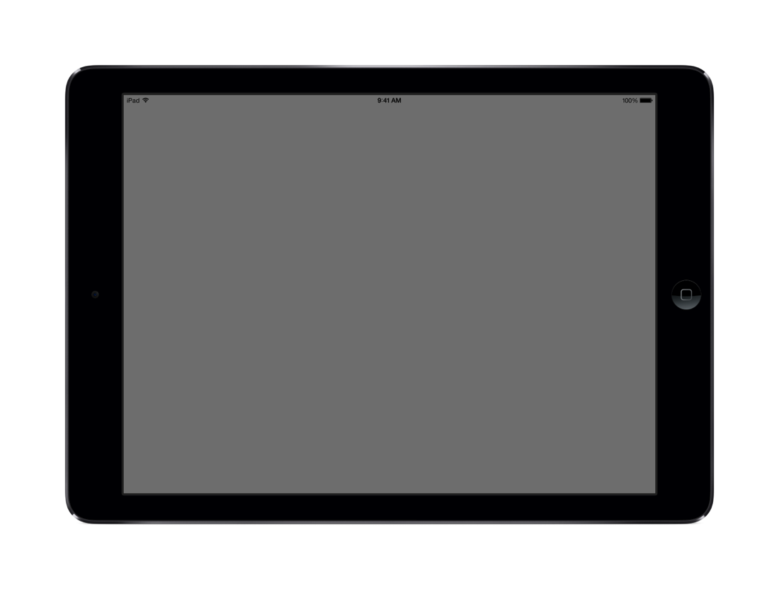

Slide 21
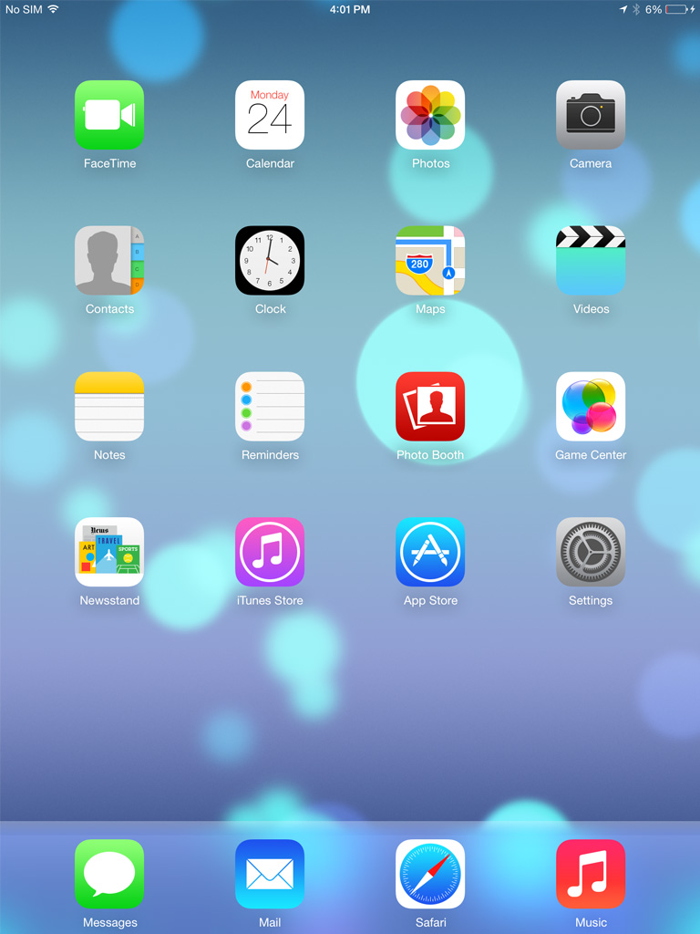

Slide 22
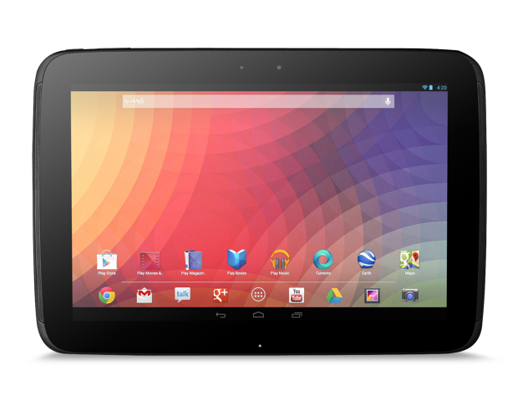
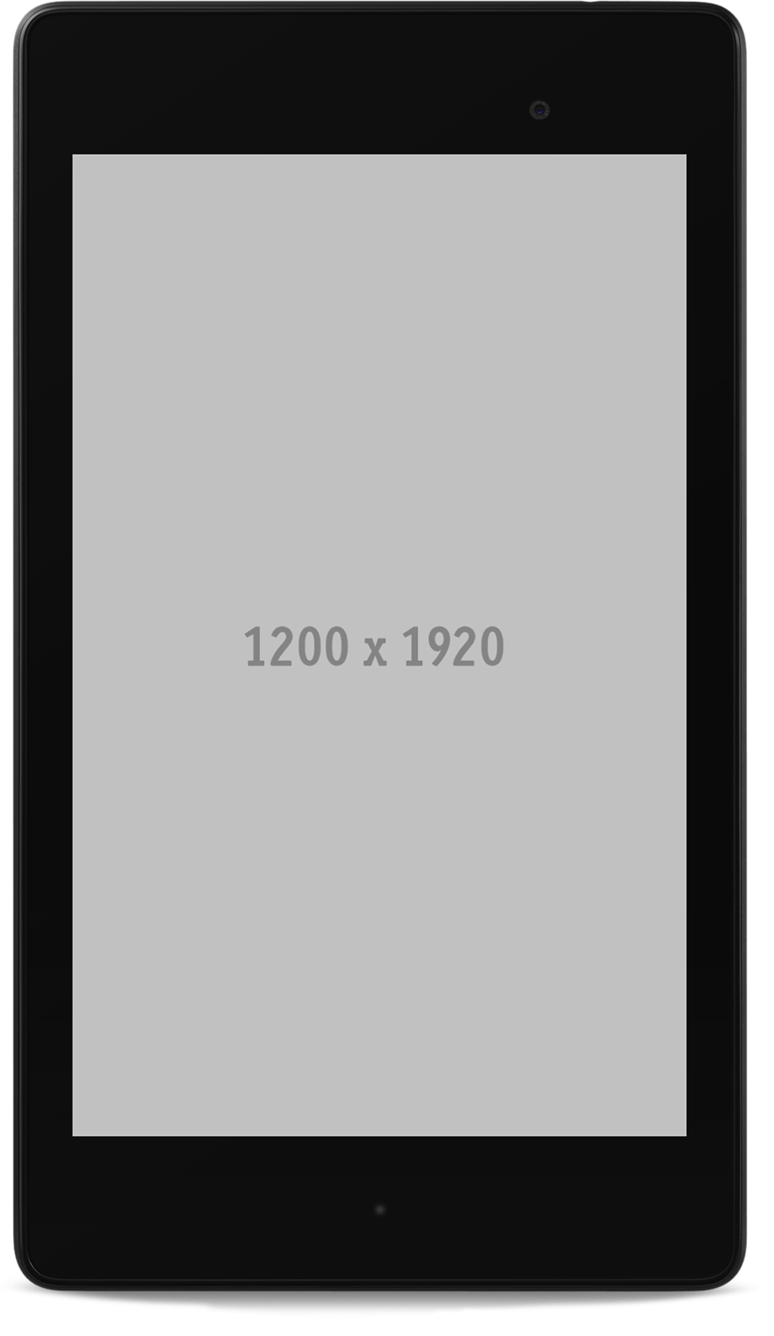
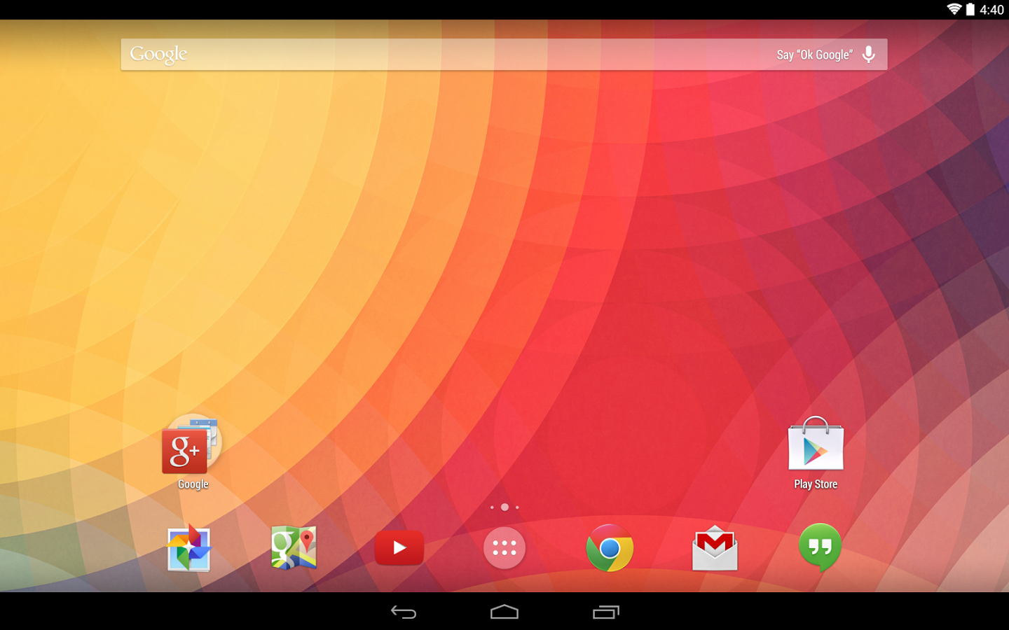


Slide 23
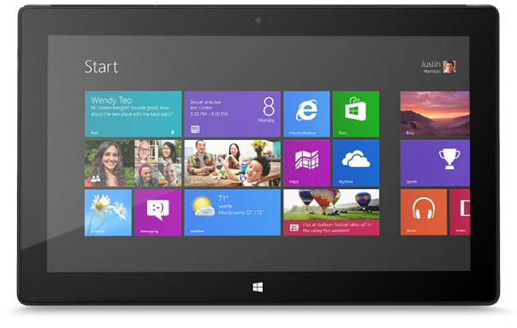
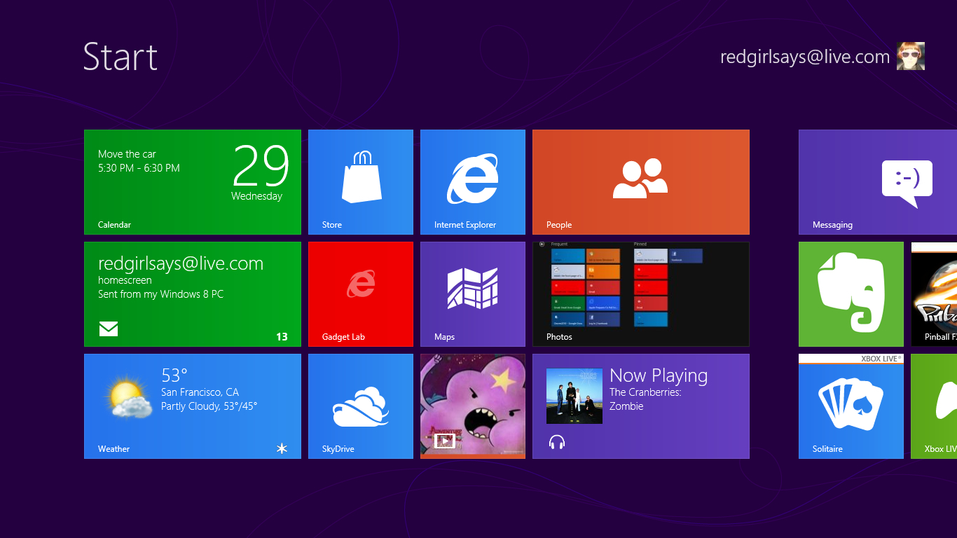

Slide 24

Icons, large and small
Large icons should be no bigger than 680px
The minimum size of icon is 80px
Minimum size
680px
80px
680px

Slide 25


Three icons in a row
When displaying three icons, make the icons 340px square with 200px between.
340px
200px
340px

Slide 26

Four icons in a grid
320px
200px
320px
88px

Slide 27










Light blue icons for reuse
System icon
Phone icon
Tablet icon

Slide 28


























More light blue icons for reuse
Functional icon
Common icon
Social icon

Slide 29












Dark icons for reuse
System icon
Phone icon
Tablet icon

Slide 30






























More dark icons for reuse
Functional icon
Common icon
Social icon

Slide 31












White icons for reuse
System icon
Phone icon
Tablet icon

Slide 32






























More white icons for reuse
Functional icon
Common icon
Social icon

Slide 33

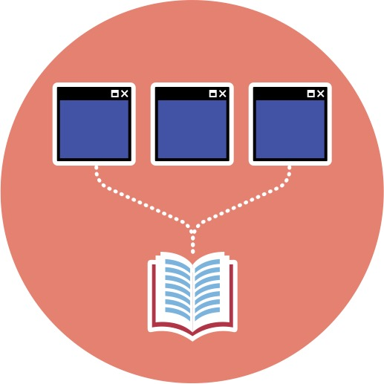



Icons from Evolve 2014
iOS Designer
Xamarin Studio
Android Wear
PCL & NuGet
Xamarin.Forms
Fast Boot
OS X & Windows
ADB Sync
Drag & drop APKs
Accelerated GFX

Slide 34


Icons from Evolve 2014
Learn Languages
Explore APIs
Iterate
Automate locally
Run on devices in the cloud
Write
Build
Run
Sketch

Slide 35

Icons from Evolve 2014
C# Support
VS Integration
Video Recording
Parallel Execution
Test cloud
One API, All Platforms
.NET and C# Native
Comprehensive
Private & Secure

Slide 36
Icons from Evolve 2014
Apps
Servies

Slide 37



Want more icons?
Check out http://ionicons.com/ – an MIT-licensed vector icon collection. Each icon is available as an SVG that you can open in Sketch, tweak the size, color, etc., and paste directly into Keynote.

Slide 38
Rebranded Slides Samples

Slide 39







We’re here to help
Stephanie Schatz
Anuj
Bhatia
David
Hathaway
SVP Sales
Customer Success
Technical Key Account Manager
Technical Key Account Manager
stephanie@xamarin.com
anuj@xamarin.com
anuj@xamarin.com
+1 (617) 697-5241
+1 (415) 283-9742
+1 (415) 283-9742
@she_travels
@anooj
@anooj

Slide 40
We’re here to help
Stephanie Schatz
Anuj
Bhatia
David
Hathaway
SVP Sales
Customer Success
Technical Key Account Manager
Technical Key Account Manager
stephanie@xamarin.com
anuj@xamarin.com
anuj@xamarin.com
+1 (617) 697-5241
+1 (415) 283-9742
+1 (415) 283-9742
@she_travels
@anooj
@anooj

Slide 41
We’re here to help
Stephanie Schatz
Anuj
Bhatia
SVP Sales
Customer Success
Technical Key Account Manager
stephanie@xamarin.com
anuj@xamarin.com
+1 (617) 697-5241
+1 (415) 283-9742
@she_travels
@anooj

Slide 42
We’re here to help
Stephanie Schatz
Anuj
Bhatia
SVP Sales
Customer Success
Technical Key Account Manager
stephanie@xamarin.com
anuj@xamarin.com
+1 (617) 697-5241
+1 (415) 283-9742
@she_travels
@anooj

Slide 43



“Xamarin's architectural approach provides completely native UIs with better performance than other cross-platform techniques… Xamarin uses multifaceted technology built by a cohesive team with a solid long-term track record.”
Gartner Strongly Endorses Xamarin Technology
Name
Gartner
August 2013
Title and Company
Notes:
You may not use the photo of Jessica; find your own quote author photos.
Photo chang: PowerPoint doesn’t support drawing mask tools, so you need to send us your profile photo when you edit your slides. We will edit your photo for you! serena.zhang@xamarin.com

Slide 44

“With Xamarin, developers combine all of the productivity benefits of C#, Visual Studio 2013 and Windows Azure with the flexibility to quickly build for multiple device targets.”
S.Somasegar
Corporate Vice President
Microsoft
Notes:
You may not use the photo of Jessica; find your own quote author photos.
Photo chang: PowerPoint doesn’t support drawing mask tools, so you need to send us your profile photo when you edit your slides. We will edit your photo for you! serena.zhang@xamarin.com

Slide 45
“With Xamarin, developers combine all of the productivity benefits of C#, Visual Studio 2013 and Windows Azure with the flexibility to quickly build for multiple device targets.”
S.Somasegar
Corporate Vice President
Microsoft
Notes:
You may not use the photo of Jessica; find your own quote author photos.
Photo chang: PowerPoint doesn’t support drawing mask tools, so you need to send us your profile photo when you edit your slides. We will edit your photo for you! serena.zhang@xamarin.com

Slide 46
“With Xamarin, developers combine all of the productivity benefits of C#, Visual Studio 2013 and Windows Azure with the flexibility to quickly build for multiple device targets.”
S.Somasegar
Corporate Vice President
Microsoft
Notes:
You may not use the photo of Jessica; find your own quote author photos.
Photo chang: PowerPoint doesn’t support drawing mask tools, so you need to send us your profile photo when you edit your slides. We will edit your photo for you! serena.zhang@xamarin.com

Slide 47



“I was looking to pick the most common Android devices, and then discovered that the top 100 only covered about a third of our users.”
Mike Shaver
Engineering Director
Facebook
Notes:
You may not use the photo of Jessica; find your own quote author photos.
Photo chang: PowerPoint doesn’t support drawing mask tools, so you need to send us your profile photo when you edit your slides. We will edit your photo for you! serena.zhang@xamarin.com

Slide 48
Title Size 80pt
Subtitle
Content 45pt
Sed diam nonumy eirmod
Tempor invidunt aliquyam erat
Labore et dolore magna
At vero eos et accusam
Et justo duo dolores
Content 45pt
Sed diam nonumy eirmod
Tempor invidunt aliquyam erat
Labore et dolore magna
At vero eos et accusam
Et justo duo dolores
Notes:
This slide is your bread-and-butter.

Slide 49
Title Size 80pt
Subtitle
Content 45pt
Sed diam nonumy eirmod
Tempor invidunt aliquyam erat
Labore et dolore magna
At vero eos et accusam
Et justo duo dolores
Content 45pt
Sed diam nonumy eirmod
Tempor invidunt aliquyam erat
Labore et dolore magna
At vero eos et accusam
Et justo duo dolores

Slide 50
Title Size 80pt
Subtitle
Content 45pt
Sed diam nonumy eirmod
Tempor invidunt aliquyam erat
Labore et dolore magna
At vero eos et accusam
Et justo duo dolores
Content 45pt
Sed diam nonumy eirmod
Tempor invidunt aliquyam erat
Labore et dolore magna
At vero eos et accusam
Et justo duo dolores

Slide 51
Title Size 80pt
Subtitle
Content 45pt. Duis autem vel eum iriure dolor in hendrerit in vulputate velit esse molestie consequat, vel illum dolore. Duis autem vel eum iriure dolor in hendrerit in vulputate velit esse molestie consequat, vel illum dolore. Duis autem vel eum iriure dolor in hendrerit in vulputate velit esse molestie consequat, vel illum dolore.

Slide 52
Title Size 80pt
Subtitle
Content 45pt. Duis autem vel eum iriure dolor in hendrerit in vulputate velit esse molestie consequat, vel illum dolore. Duis autem vel eum iriure dolor in hendrerit in vulputate velit esse molestie consequat, vel illum dolore. Duis autem vel eum iriure dolor in hendrerit in vulputate velit esse molestie consequat, vel illum dolore.

Slide 53
Title Size 80pt
Subtitle
Content 45pt. Duis autem vel eum iriure dolor in hendrerit in vulputate velit esse molestie consequat, vel illum dolore. Duis autem vel eum iriure dolor in hendrerit in vulputate velit esse molestie consequat, vel illum dolore. Duis autem vel eum iriure dolor in hendrerit in vulputate velit esse molestie consequat, vel illum dolore.

Slide 54

One image on slide
Subtitle
Content 45pt
Use dark blue or light blue background for the image slide.
Image area
Text area
Notes:
This slide is your bread-and-butter.

Slide 55
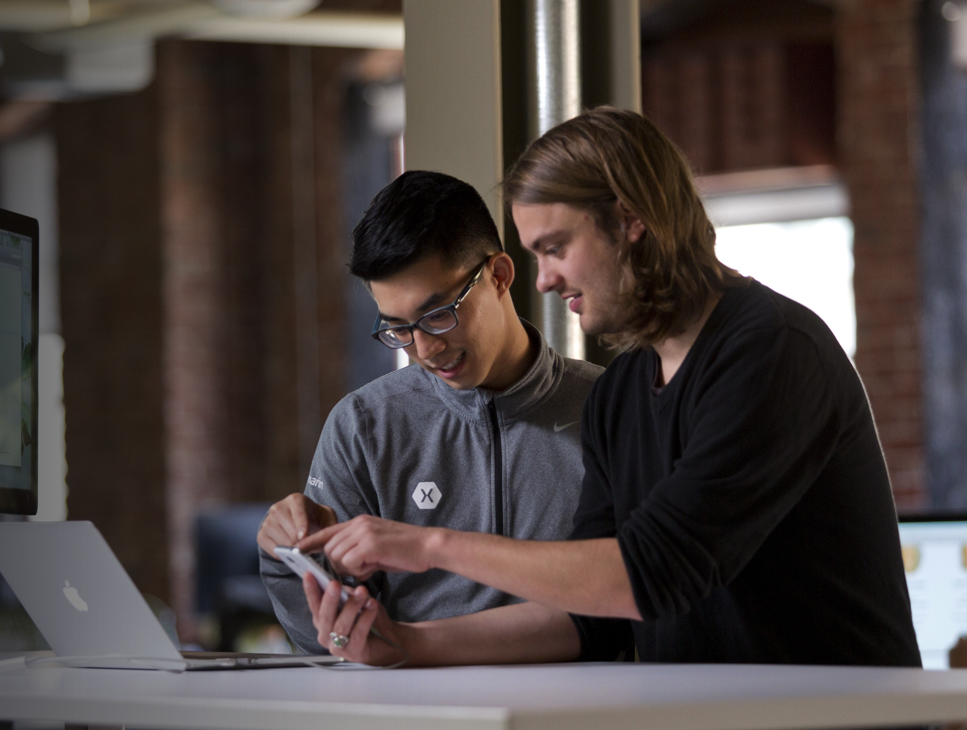

Two images on slide
Image area
Image area
Content 32pt. Tempor invidunt aliquyam erat Labore et dolore magnaTempor invidunt aliquyam erat Labore et dolore magna
Content 32pt. Tempor invidunt aliquyam erat Labore et dolore magnaTempor invidunt aliquyam erat Labore et dolore magna
Notes:
This slide is your bread-and-butter.

Slide 56
Three images on slide
This text shape has no fill. It uses the same default interior margins as content tiles
Align all text blocks to the content tiles interior margins
Text can be used on, above or below photos.
Notes:
Images should all be the same size. Please make your photos are 280px by 210px and use the shape mask to change your to image. See instruction on Slide11.

Slide 57
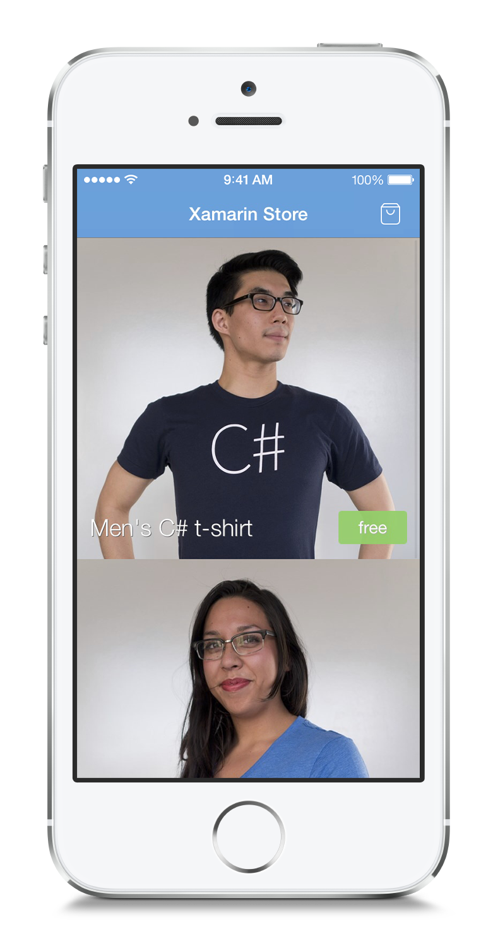
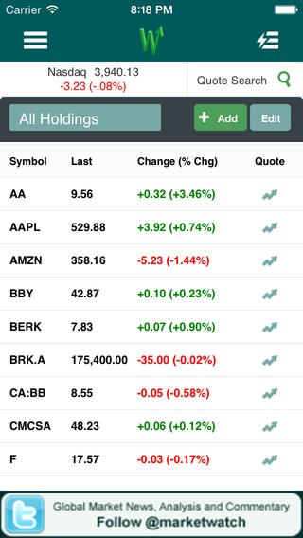
Title Size 80pt
Subtitle
MVVM pattern
Xamarin.Mobile
Signature control from Component
StoreSQLite for storage on all 3 platforms

Slide 58
Title Size 80pt
App Features
Location-based assignments / routing
Time recording
Camera capture of work
Signature capture
Cross-Platform Technique
MVVM pattern
Xamarin.Mobile
Signature control from Component

Slide 59

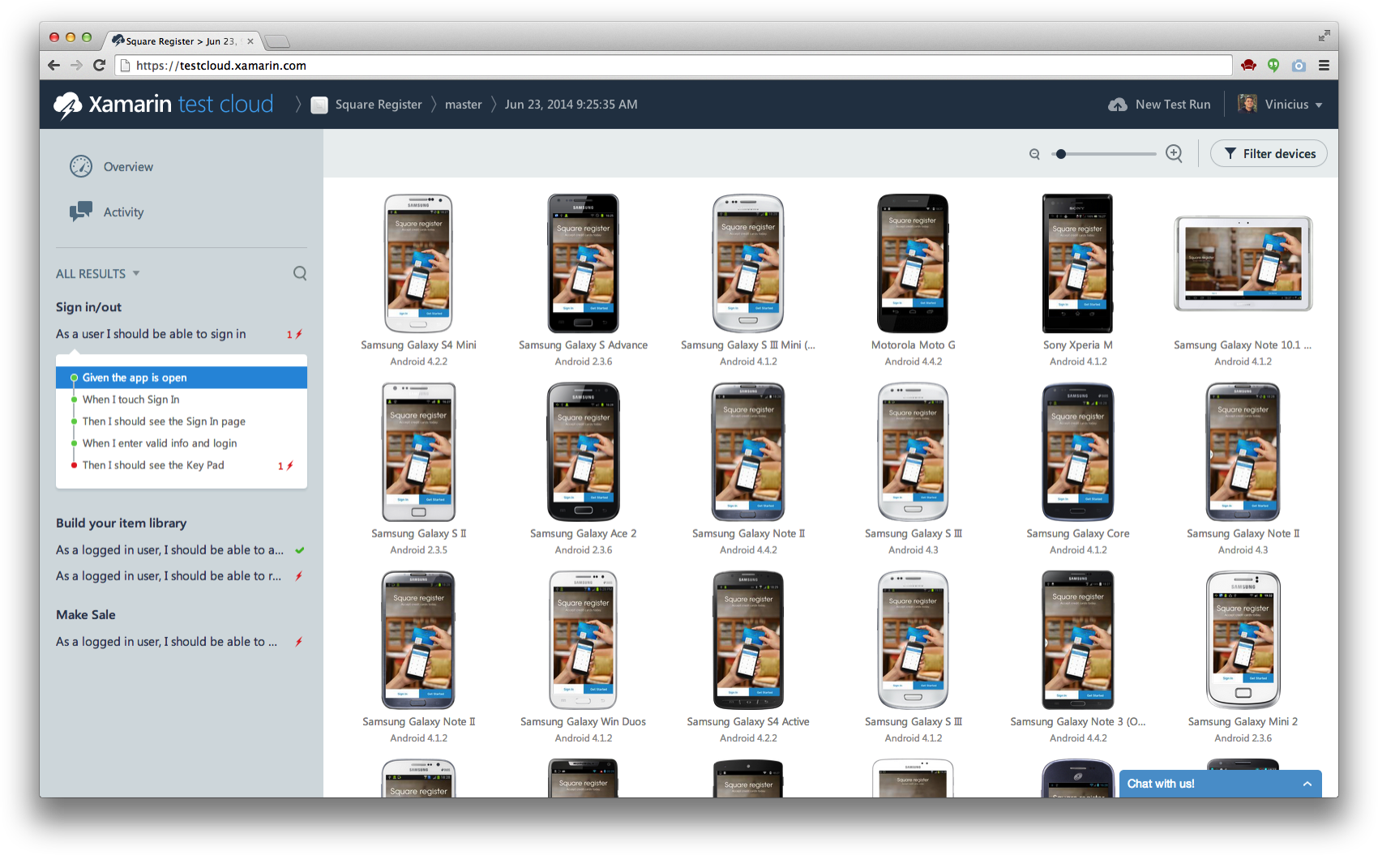

Slide 61
Rebranded Case Studies

Slide 62
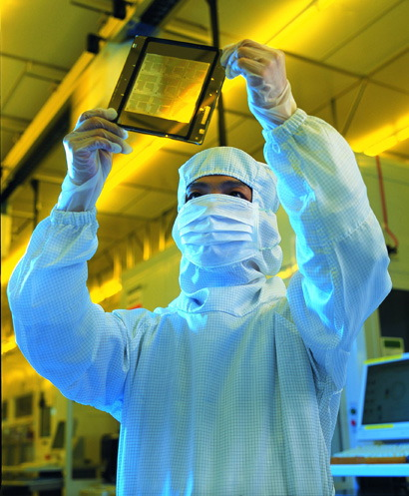
Fully Integrated Native Mobile CRM
About Kimberly Clark
$20 Billion in Revenue
A Fortune 150 Company
Well known consumer brands such as Kleenex, Huggies, and Scott
Professional Products division supplying safety and scientific products to variety of industries including Automotive, Aerospace,Manufacturing, Oil & Gas, Pharmaceutical, and Semi-Conductor

Slide 63
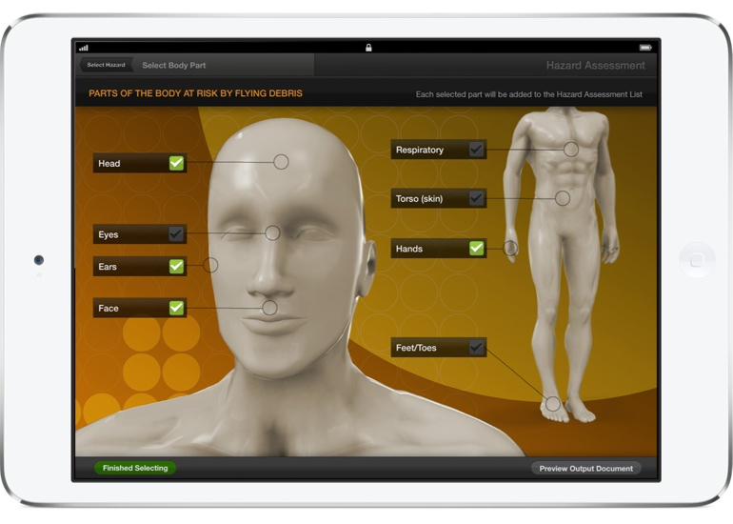
Fully Integrated Native Mobile CRM
Challenge
Transform sales process with mobile CRM solution
Gain sales rep adoption
Streamline and accelerate the proposal process
Enable realtime collaboration
Full backend integration with Sitecore CMS & Salesforce

Slide 64
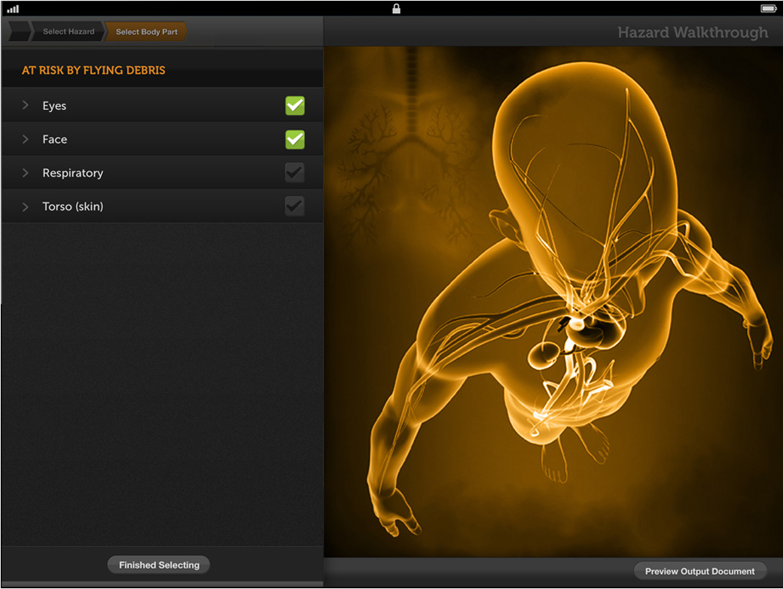
Fully Integrated Native Mobile CRM
Result
Revolutionary 3D User Interface
High adoption rates by enterprise users
Significantly increased close rates and a 50% reduction in sales cycle time
High customer satisfaction rates

Slide 65

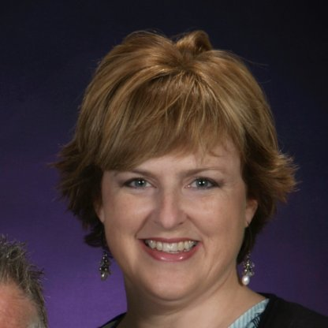
Fully Integrated Native Mobile CRM
Grant Davies
Kim MacDougall
Developer of field sales app
Kimberly-Clark
DevSenior Capability Development Manager
Kimberly-Clark
“We trust the Xamarin platform with our mission-critical enterprise app development. The stability of the platform, combined with Xamarin's deep native user experience capabilities, is unmatched.”
"The results from our new field sales app are phenomenal — our sales people love the app and are able to engage customers and close deals more effectively. Key to the app's success is the beautiful, fast user experience made possible by Xamarin."

Slide 66

From No Mobile Experience to Quick Success
About Dow Jones MarketWatch
A Dow Jones propery, MarketWatch is one of the most visited financial websites in the world with over 16 million visitors per month
Leading innovator in business news, personal finance, and investment tools and data
Part of the Wall Street Digital Network, which includes WSJ.com, Barrons.com among others

Slide 67

From No Mobile Experience to Quick Success
Challenge：Meet Skyrocketing Mobile Traffic with a Great App
MarketWatch’s high-end users making critical financial decisions demand a fast, easy-to-use app
Web team tasked with building mobile app on tight deadlines, but with no mobile experience
App is very data-intensive, initial attempts with HTML5 couldn’t handle

Slide 68
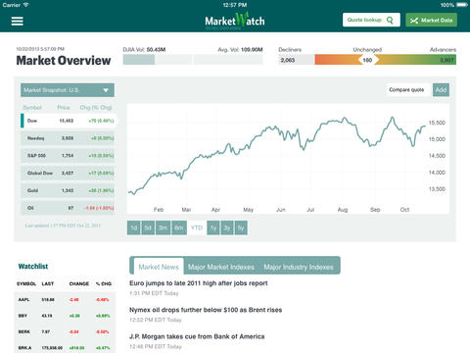
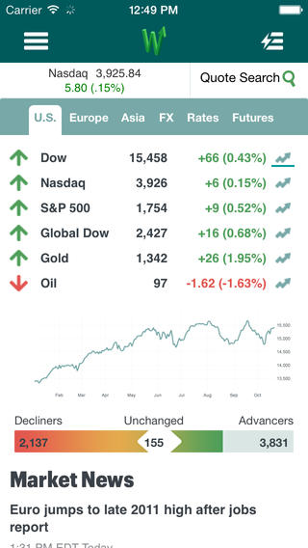
From No Mobile Experience to Quick Success
Result
With no mobile experience, team leveraged Visual Studio to create native iOS app in 6 months
Xamarin app replaced existing HTMLT app for better user experience and performance
Estimated 90% code-sharing with an Android app that is currently in development

Slide 69
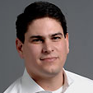
From No Mobile Experience to Quick Success
"Mobile is an increasingly strategic channel for us to engage with our readers. Xamarin made it possible for our team to build an app much more quickly than we otherwise could have."
Ian Rosen
VP, General Manager
MarketWatch & SmartMoney

Slide 70
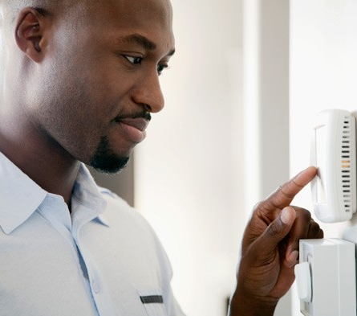
Where Business Meets IT
About Direct Energy
The largest home services and energy provider in North America
Operates in 46 states and 10 Canadian provinces
More than 6 million active customers
6,000 employees and over $9 Billion in annual revenue

Slide 71


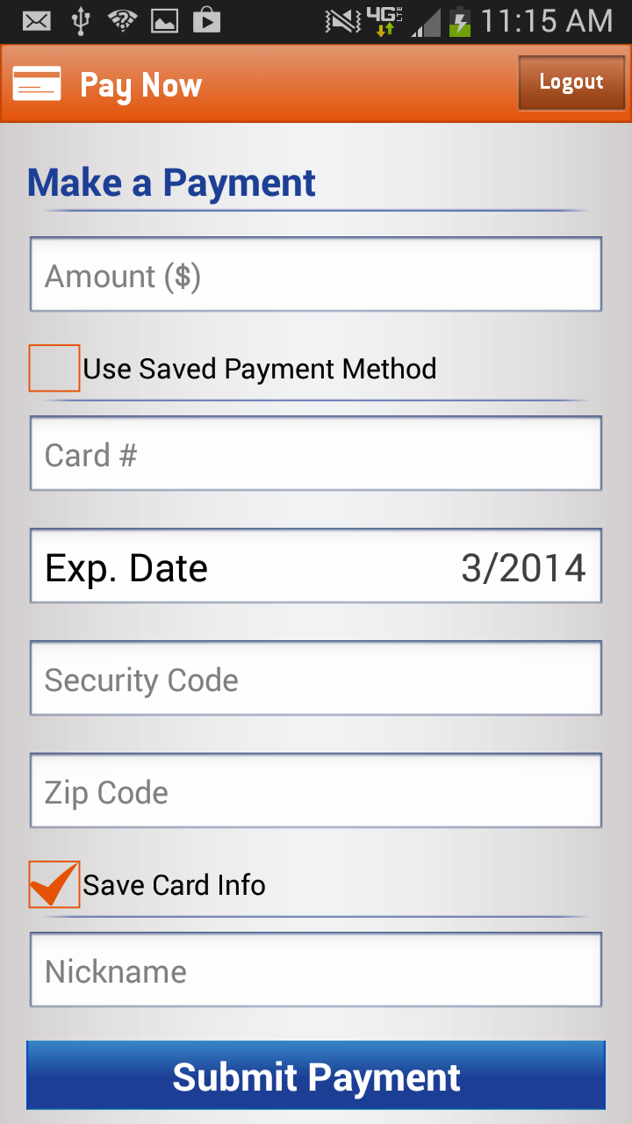
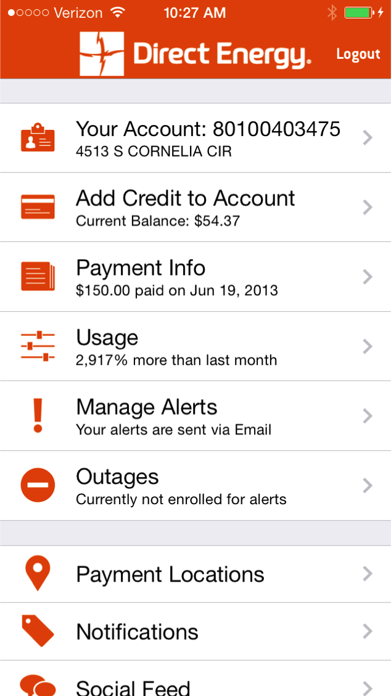
Where Business Meets IT
Challenge
Deliver a great app experience on multiple platforms in the highly competitive retail energy space
Leverage existing .NET skills and avoid staffing multiple platform-specific teams and maintaining parallel codebases

Slide 72
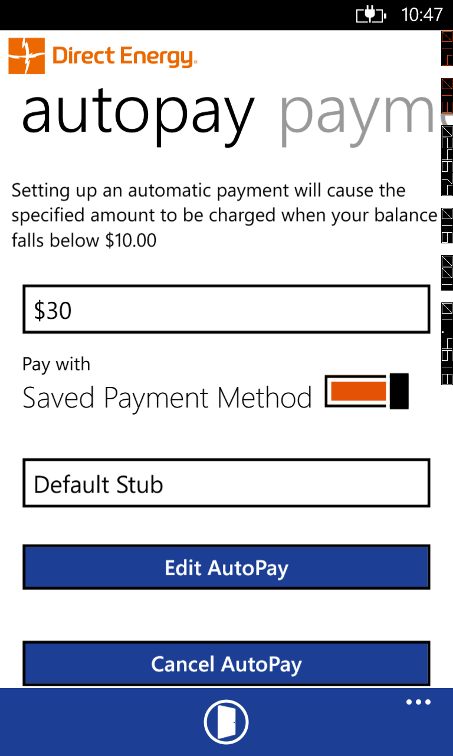
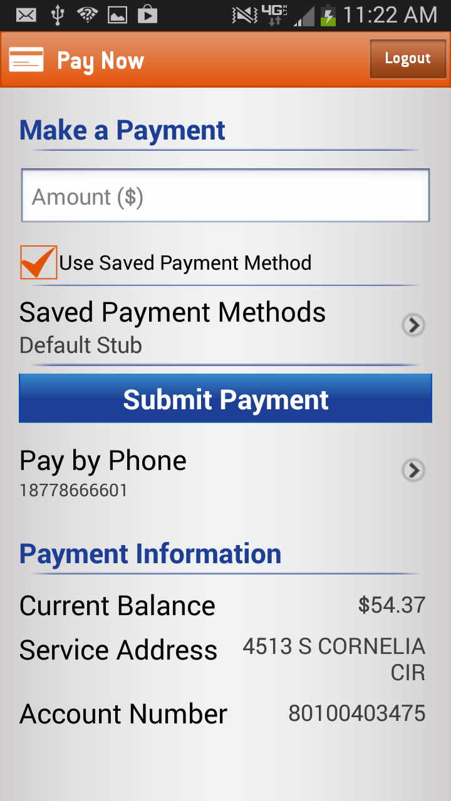

Where Business Meets IT
Result
Xamarin won the technology selection, over MEAPs and HTML5 frameworks, as the perfect fit for both the business and IT stakeholders
Initial iOS app designed and deployed in just 6 weeks. 90% of code is shared across iOS, Android and Windows Phone.

Slide 73


Where Business Meets IT
Monte Beck
Brian Orrell
CMO
Direct Energy
CMO
Direct Energy
“A growing portion of Direct Energy’s customer base live and die by their smartphones. We wanted to engage this growing audience in a way that is familiar to them, with a great, native app on multiple platforms. Pariveda and Xamarin made this possible.”
“Xamarin is a critical part of Pariveda’s growing mobile success and expertise. We are able to deliver fully native apps very quickly—something not possible with any other solution.”

